Slide 1

INX FUTURE INC
EMPLOYEE PERFORMANCE ANALYSIS
Presented By:
Muchoki Jacob Maina
26th September 2025

Slide 2

INTRODUCTION
Brief Background :
INX Future Inc. is a leading data analytics and automation provider with a strong reputation for employee-friendly policies. Recently, employee performance has declined, causing service issues and an 8% drop in client satisfaction.
Context / Industry Relevance :
In the data analytics and automation industry, employee performance drives service quality, client satisfaction, and competitiveness. Identifying the causes of underperformance is crucial to maintain productivity and preserve INX’s reputation as a top employer.
PROJECT
OBJECTIVES
Analyze department-wise and other features contributing to employee performance.
Identify top factors affecting performance.
Build a predictive model for employee performance to support hiring decisions.
Provide recommendations to improve performance while maintaining morale.

Slide 3
PROBLEM STATEMENT
Business Problem :
Research Objectives :
INX has observed declining employee performance, affecting service quality and client satisfaction.
CEO wants to address the issue without penalizing employees in a way that reduces overall morale or harms the company’s reputation.
Enable management to improve performance while maintaining employee morale and sustaining INX’s status as a top employer.
Goal :
Examine employee performance.
Identify key features contributing to low performance.
Predict non-performing employees to guide targeted interventions.

Slide 4

DATA DESCRIPTION
Data Overview
Source Data
Feature Types
Number of records: 1,200 employees
Number of features: 28
Missing values: None
Duplicates: None
Data types: Integer, Object
Employee performance data of INX Future Inc.
Download link: INX Employee Performance Data
Nominal: 8 features
Ordinal: 9 features
Numerical:11features

Slide 5




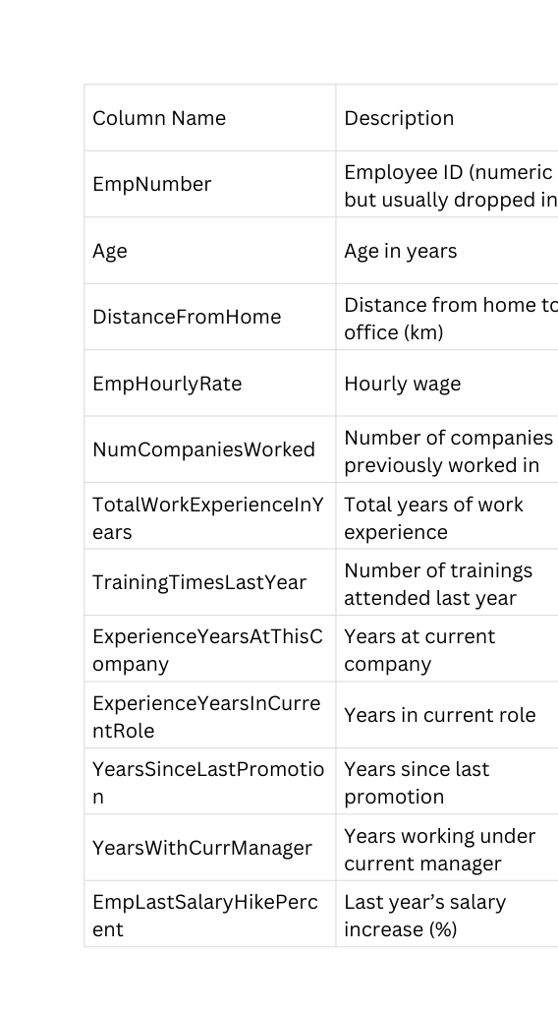
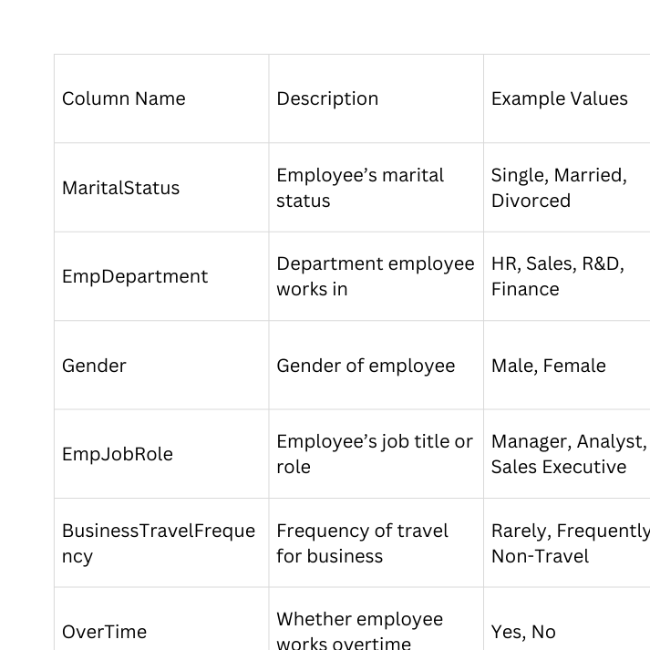
Data Description :
Numerical Features
Nominal Features
Ordinal Features
Column Name | Scale (1 = Low → High = 4/5) | Description
EmpEducationLevel | 1–5 | Level of education (1 = lowest, 5 = highest)
EmpEnvironmentSatisfaction | 1–4 | Environment satisfaction
EmpJobInvolvement | 1–4 | Degree of involvement in job
EmpJobLevel | 1–5 | Employee’s level in the company
EmpWorkLifeBalance | 1–4 | Work–life balance
EmpJobSatisfaction | 1–4 | Satisfaction with job
EmpRelationshipSatisfaction | 1–4 | Satisfaction with relationships at work

Slide 6
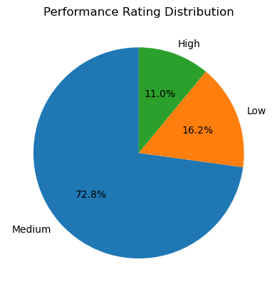
Exploratory Data Analysis
Performance Rating Distribution :
From the analysis of employee performance:
Medium performers: 72.8% - 874 Employees
Low performers: 16.2% - 194 Employees
High performers: 11.0% - 132 Employees
This shows that the majority of employees fall in the medium performance category, with fewer low and high performers.

Slide 7
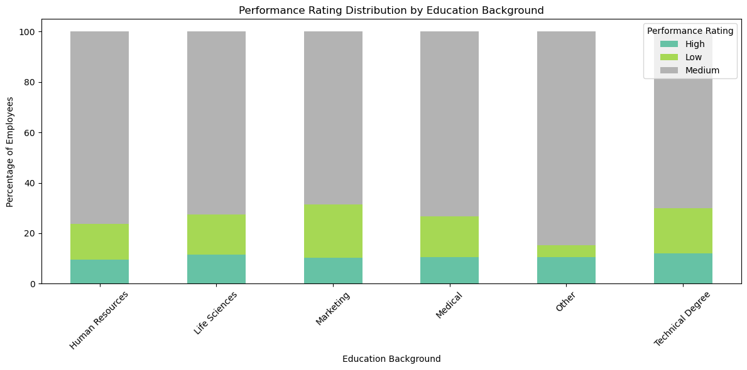
Exploratory Data Analysis
Performance Rating Distribution by Education Background :
Across all education backgrounds, medium performance dominates.
Employees with Marketing backgrounds show the highest percentage of low performance compared to other groups.
Other education backgrounds show very low percentages of low performance.

Slide 8
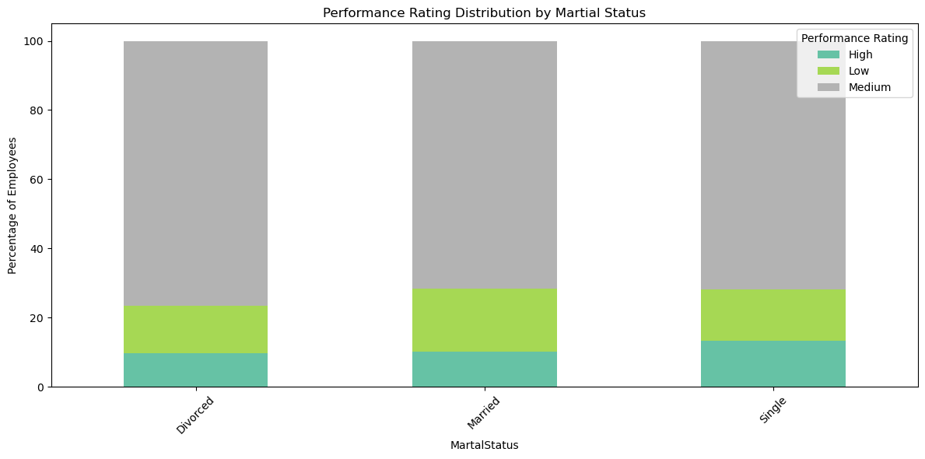
Exploratory Data Analysis
Performance Rating Distribution by Martial Status :
Performance distribution is similar across marital statuses.
Medium performance dominates for all groups.
Employees who are single show a slightly higher percentage of high performance compared to married or divorced employees.
Employes who are married show slighty higher percentage of low performance comapred to single and divorced

Slide 9
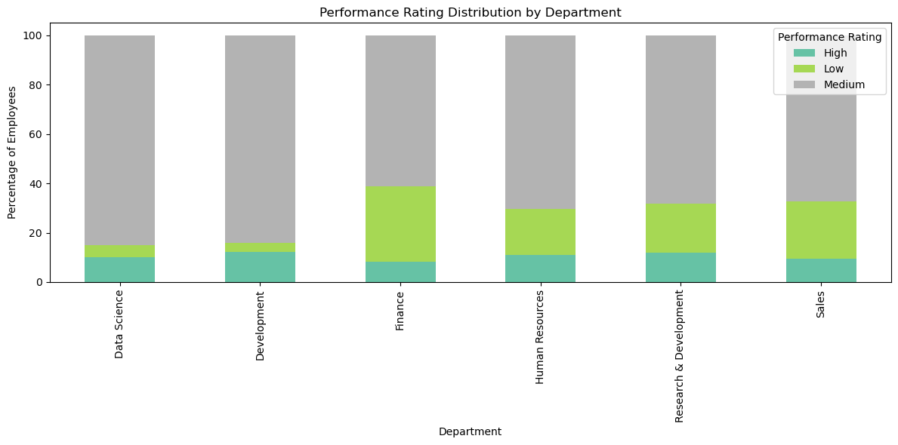
Exploratory Data Analysis
Performance Rating Distribution by Department :
Across departments, medium performance is dominant.
Finance employees show the highest percentage of low performance.
Development employees show the lowest percentage of low performance.

Slide 10
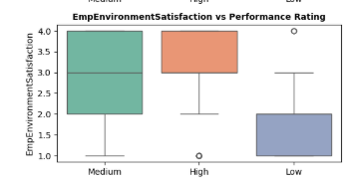
Exploratory Data Analysis
Environment Satisfaction vs Performance Rating :
High performers tend to have slightly higher environment satisfaction scores compared to Low.
Suggests satisfaction with the work environment may contribute positively to performance.

Slide 11
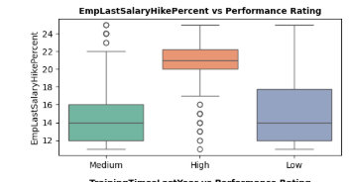
Exploratory Data Analysis
Last Salary Hike Percent vs Performance Rating :
Employees with High performance seem to have received slightly higher salary hikes.
Suggests performance may influence salary increment decisions.

Slide 12
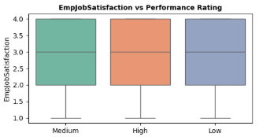
Exploratory Data Analysis
Job Satisfaction and Performance Relationship :
Employees with high performance ratings tend to report slightly higher levels of job satisfaction compared to those with low performance ratings.
Suggesting
When employees are satisfied with their roles, environment, and recognition, they are more motivated, engaged, and committed.
This positive attitude can translate into improved performance.

Slide 13
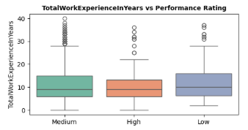
Exploratory Data Analysis
Total Work Experience In Years vs Performance Rating :
High performers tend to cluster around lower–mid experience levels,
Low performers have more spread (many with higher years).
Too much experience doesn’t necessarily guarantee high performance.

Slide 14
Exploratory Data Analysis
Key Insights Summary :
Performance Drivers → Employee engagement, satisfaction, promotions, training, and fair salary hikes strongly influence performance.
Weak/Minimal Factors → Age, commute distance, education, job level, and manager tenure show little impact.
Departments & Roles → Finance shows higher low performance; Developers mostly medium; singles tend to perform better.
Correlation → Some experience-related features are moderately correlated but not severe; a few features (Age, NumCompaniesWorked, Department) may be redundant.
Overall: Employee growth opportunities, satisfaction, and rewards are the core factors driving performance at INX.

Slide 15

Data Preprocessing :
Dataset Split
Train set: 960 samples
Test set: 240 samples
Observed imbalance in PerformanceRating:
Class 3 → 874 samples
Class 2 → 194 samples
Class 4 → 132 samples
Handling Class Imbalance
Balances categorical + numerical features.
After resampling, dataset becomes balanced with 690 samples per class.
Apply SMOTENC
Preprocessing Pipeline
Used ColumnTransformer to ensure consistent transformations.
Categorical features: OneHotEncoder
Numerical features: StandardScaler
ordinal numeric features
StandardScaler
Handles different data types correctly.
Prevents data leakage by fitting only on training data.
Ensures features are normalized and comparable.
Benefits
Purpose :
These preprocessing steps ensure that the model receives balanced, clean, and properly scaled inputs, improving training stability and performance.

Slide 16
MODEL TRAINING
Goal :
Hyperparameter Tuning
Train models to predict employee performance based on input factors.
Insights will assist in making data-driven hiring decisions.
Used RandomizedSearchCV to optimize model parameters.
Improves model performance by systematically searching across parameter combinations.
Models Used :
Dimensionality Reduction
Logistic Regression
K-Nearest Neighbors (KNN)
Decision Tree
Random Forest
Gradient Boosting
Support Vector Classifier (SVC)
Deep Learning (ANN)
Applied PCA (Principal Component Analysis) to:
Reduce dimensionality.
Speed up training.
Retain most important variance in the data.

Slide 17
MODEL PERFORMANCE
Hyper parameter Tuning :
Deep Learning Model
Applied RandomizedSearchCV for optimization.
Did not show significant improvement in accuracy → default parameters were already near-optimal for this dataset.
Trained effectively on training data.
Performance dropped on unseen data (accuracy = 0.82) → shows overfitting.
PCA (Dimensionality Reduction)
Model Performance :
Ensemble Models performed best due to combining multiple learners:
Gradient Boosting → 0.91
Random Forest → 0.92 (highest)
Other models:
Support Vector Classifier (SVC) → 0.82
Logistic Regression → 0.76
KNN → 0.60 (lowest)
Reduces feature space by compressing information into fewer components.
Trade-off: speeds up training but may discard useful details, leading to reduced classification performance.

Slide 18

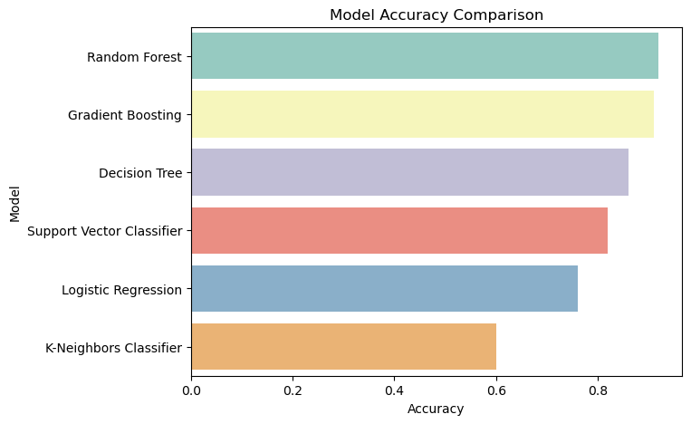
Model Evaluation
Purpose :
Assess model performance on unseen test data.
Ensure models generalize well and are not overfitting.
Evaluation metrics :
Classification Report → provides detailed performance metrics (precision, recall, F1-score, support) to understand how well the model performs across different classes.
Accuracy Score → shows the overall proportion of correct predictions, useful for comparing models at a glance.
Result :
✅ Random Forest stood out with the highest accuracy of 92%.

Slide 19
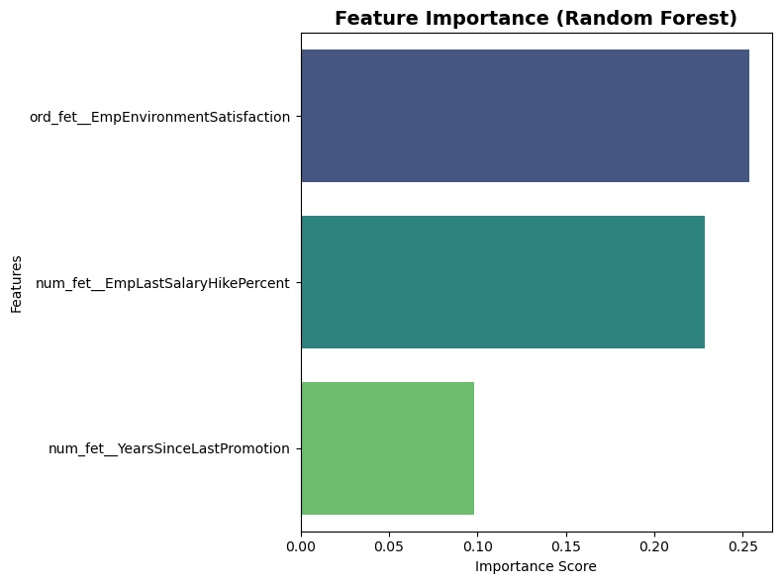
Feature importance
Top Features from Ensemble Models :
After training with ensemble models, the 3 most important features ranked were:
EmpEnvironmentSatisfaction
EmpLastSalaryHikePercent
YearsSinceLastPromotion
Why Feature Importance Assists :
Identifies key drivers of employee performance.
Guides decision-making → helps HR focus on the most impactful factors.
Supports feature selection → remove less useful inputs, improving efficiency.
Improves interpretability → makes the model’s predictions explainable.
Enables actionable insights → management can target policies based on top drivers.

Slide 20
Recommendation :
Prioritize employee satisfaction → focus on improving work environment and engagement.
Review salary hike policies → fair and regular adjustments can boost motivation and retention.
Monitor promotions closely → long gaps without promotion negatively impact performance.
Adopt data-driven hiring → use model predictions to select candidates likely to perform well.
Focus on top drivers → direct resources to areas proven to influence performance most.
Actionable Insights from Data :
EmpEnvironmentSatisfaction → Improving work culture directly enhances performance.
EmpLastSalaryHikePercent → Competitive salary increments help sustain motivation.
YearsSinceLastPromotion → Regular promotion cycles encourage long-term employee growth.

Slide 21

CONCLUSION
By considering the analysis, the project will help INX Future Inc. in solving the core underlying causes of performance issues.
Provides clear indicators of non-performing employees, ensuring that any necessary penalization can be handled carefully without significantly affecting overall employee morale.
The trained model can analyze current employees’ performance and also predict future employee performance based on input factors.
This will support both performance management and data-driven hiring decisions.

